Slide 1
Project Presentation Templates

Slide 2
Topic Description
Title
Title of your product, service, or business
Motivations
Why do you choose this topic?
Goals and/or Objectives
What are your major goals of your project?
What do you expect to learn from your project?
Project Schedule
Describe your project schedule (eg. Gantt chart..) and milestones.

Slide 3
Environmental Analysis
ITEM
ITEM Description *
Perspective in the analysis (Provider, User, Subscriber, Employees or Employer, …)
Technologies adopted
Current Status and Future Prospects of the Item & Technology
Market
Customer Analyses : Target Customer, Characteristics of the customers
Competitors Analyses : Existing & Emerging Competitors
Market Analyses : Market Size, Market Growth, Market Saturation, Expected Life Cycle
Regulations
← * Describe at least 1 page in each Headline, and Specify the reference source, year of publication

Slide 4
Cost and Benefit Analysis
Item Identification
Cost Item ( Individual Case, example)
Purchase Cost
Maintenance Cost
Operating Cost
Other Costs
Benefit Item (Individual Case, example)
 | Tangible | Intangible
Effectiveness | Increased Utility Decreased Disutility | Increased Satisfaction Increased Convenience Increased Portability Increased Security
Efficiency | Cost Reduction | Time Saving Reduced Complexity

Slide 5
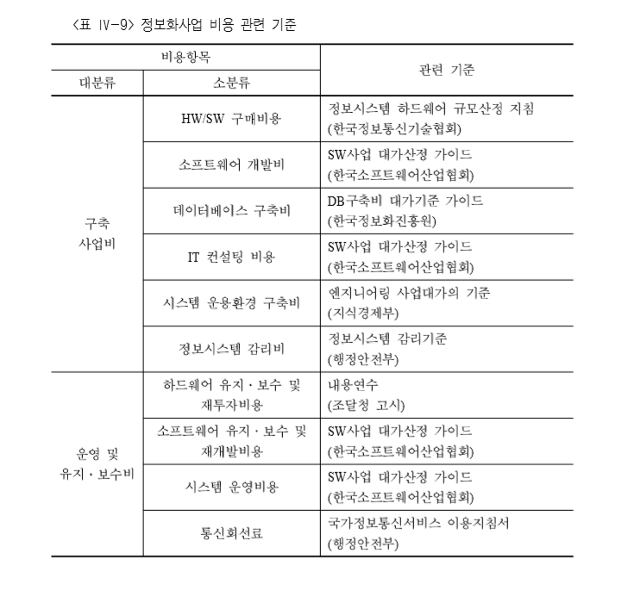
Cost and Benefit Analysis
Item Identification
Cost Item ( Guideline)

Slide 6




Cost and Benefit Analysis
Item Identification
Benefit Item (Guideline)
IT performance Metric Framework
McKinsey Model
IT Performance
IT Effectiveness
IT Efficiency
상담원
응답율
서비스
이용자수
오류
감소율
BSC Model
정보등록
건수
교육시간
감소
사용부서
만족도
Perspective 1
1. Financial
업무비용감소
사용부서 요청처리시간감소
업무처리
시간감소
정보파악
시간감소
보고서
작성시간
지식공유 비용절감
오류
감소율
업무처리
자동화율
Outcomes
Perspective 4
Perspective 2
2. Customer
IT
Effectiveness
Strategy
3. Internal Process
인당개발
건수
IT교육
시간
Qualitative
Perspective 3
4. Learning & Innovation
개발비용
감소액
유지비용
감소액
평균 응답
시간 절감
시스템 별 개별접근 비용절감
의사소통 시간절감
IT교육
비용절감
Non-Financial
Quantitative
Outcome Type
IT
Efficiency
NO
Financial
Quantitative
Nbr?
Qualitative
BSC
Yes
NO
Non-Financial
Quantitative
Financial
Customer
Internal
process
Learning &
Innovation
Fin?
Yes
Financial
Quantitative

Slide 7
Cost and Benefit Analysis
Item Identification (Continued)
3. Estimated Income Statement (Biz Case, example)
Proforma Income Statement
Revenue Direct Cost General and Administration Cost - Distribution - Sales Labor - Marketing - R&D - Administration - Depreciation Interests and Tax Net Profit

Slide 8
Cost and Benefit Analysis
Estimation Process
Cost Estimation Logic (Individual Case)
Purchase Cost : From PSM survey
Maintenance Cost : avg. # of downtime x repair cost
Operating Cost : Direct estimation of Utilities…
Other Costs : …
……
Benefit Estimation Logic (Individual Case)
Increased Utility : avg. utility price x 80%
Cost Reduction : avg. cost reduced per month x 12
Increased Satisfaction : From CVM survey
Time Saving : avg. salary per month x time saving x 50%
……

Slide 9
Cost and Benefit Analysis
Estimation Process (Continued)
3. Cost and Revenue Estimation Logic (Biz Case, example)
(← Find out Income statement of similar type of business)
Proforma Income Statement | Estimation Process
Revenue Direct Cost General and Administration Cost - Distribution - Sales Labor - Marketing - R&D - Administration - Depreciation Interests and Tax Net Profit | = Total market x market share = Revenue x % of Direct Cost = N/A = # of Labor x Avg. salary = Revenue x % of Marketing = R&D Cost = Revenue x % of Admin. = Straight Line Depreciation = Revenue x % of Interest and Tax

Slide 10
Cost and Benefit Analysis
Cash Flows
Individual Case, example
 | Y | Y+1 | …. | Y+n
Benefit - Cost Saving - Time Saving - Increased Portability
Cost - Purchase Cost - M&O Cost - Other Costs
Net Cash Flow
IRR and NPV and B/C

Slide 11
Cost and Benefit Analysis
Cash Flow (Continued)
Biz Case
 | Y | Y+1 | …. | Y+n
Cash Inflow - Net Profit - Depreciation
Cash Outflow - Investment Cost
Net Cash Flow
IRR and NPV and B/C

Slide 12
AHP Analysis
Set up Decision Tree

Slide 13
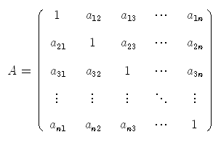
AHP Analysis
Make Pairwise Comparison Matrices

Slide 14
AHP Analysis
Calculate Weights and Scores
Check Consistency Test
Merge your processes by using geometric means when
there is a group of decision-makers
Aggregate final priorities
Describe your recommendations

